Slide 1
AI in ELT: Obstacle, facilitator or disruptor?
Richard Watson Todd
King Mongkut’s University of Technology Thonburi

Slide 2
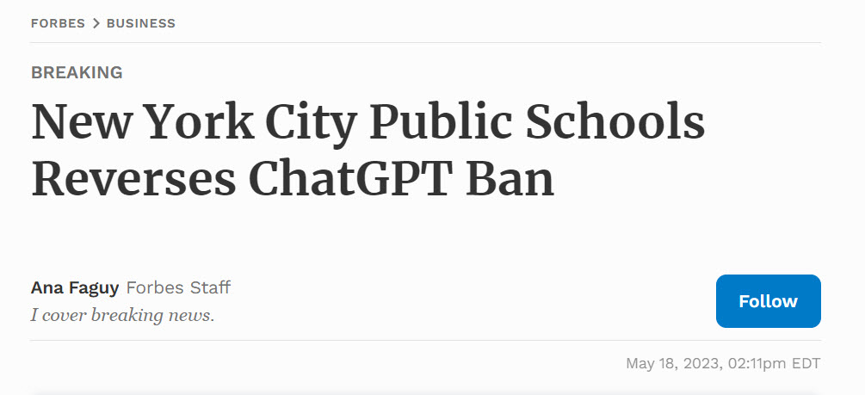
The timeline of ChatGPT
November 2022
January 2023
May
2023
September 2023
The future

Slide 3
AI as an obstacle in ELT
Equinox does not accept text, images, graphics or translations generated by Artificial Intelligence, or by AI-powered tools, as the originality of such content cannot be guaranteed. Authors of Equinox publications must be accountable for their work, and accountability cannot be effectively applied to Artificial Intelligence at this stage.
Privacy concerns

Slide 4
AI as an obstacle in ELT

Slide 5
AI as an obstacle in ELT
Use in-class paper-and-pencil or oral assessments
Make assignments
Personal
Meaningful
Real-world

Slide 6
AI as a facilitator in ELT
Answer questions
Identify genre structures
Generate course materials
Provide example sentences
Summarise information
Generate lesson plans
Prepare for exams
Provide translations
Generate assessment tasks
Highlight important phrases
Assist drafting
Evaluate student performance
Provide feedback
Explain grammar
Identify meanings of words
Lo (2023)
Kohnke et al. (2023)
Kasneci et al. (2023)
Suggest style improvements
Explain mistakes
Correct mistakes
Provide step-by-step solutions
Create genre-specific texts
Generate essay outlines

Slide 7
AI as a facilitator in ELT
Facilitating traditional educational paradigms and practices

Slide 8
AI as a facilitator of research
Where authors use generative artificial intelligence (AI) and AI-assisted technologies in the writing process, authors should only use these technologies to improve readability and language. Applying the technology should be done with human oversight and control, and authors should carefully review and edit the result, as AI can generate authoritative-sounding output that can be incorrect, incomplete or biased. AI and AI-assisted technologies should not be listed as an author or co-author, or be cited as an author.

Slide 9
AI as a disruptor of language use
C1
Somying
Somchai with AI
CEFR Level
B2
Language users only need to produce writing at a level where it is comprehensible enough for AI to edit the text to meet norms
B1
Somchai
A2

Slide 10
AI as a disruptor of ELT
“External goals relate to the students' use of language outside the classroom”
“Internal goals relate to the students' mental development as individuals”
AI is shifting external goals
Currently beyond AI
AI can prepare students for language use
Cook (2009)

Slide 11
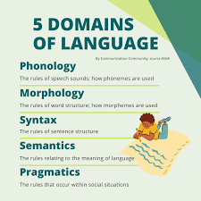
AI as a disruptor of ELT
Since the 1950s, external
goals have dominated ELT

Slide 12
AI as a disruptor of ELT
Traditional
AI era

Slide 13
AI as a disruptor of ELT

Slide 14
AI as a disruptor of ELT

Slide 15
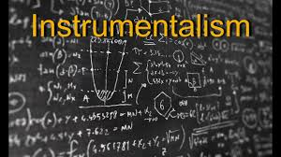
AI as a disruptor of ELT
Economic efficiency
Progressivism
Mitchell (2014)
Social reconstructionism
Notes:
Instrumentalism - a curriculum delivering a specific product such as the development of a skilled workforce
Progressivism - meeting individuals’ needs and aspirations
Liberal humanism - the use of intellectual disciplines in developing individuals
Reconstructionism - education to change society

