Slide 1
Can generative AI replace corpora in data-driven learning?
Richard Watson Todd
King Mongkut’s University of Technology Thonburi

Slide 2
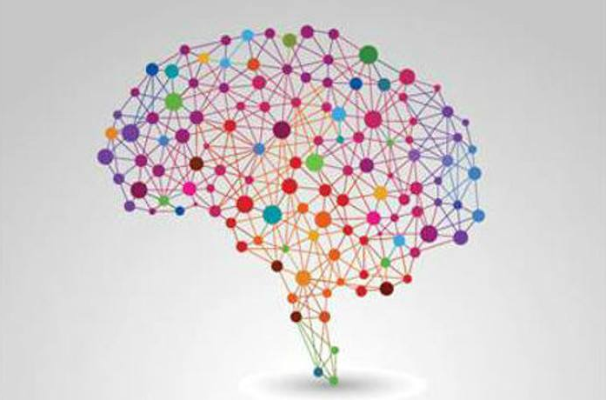
Usage-based linguistics
Data-driven learning

Slide 3
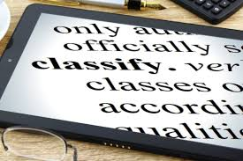
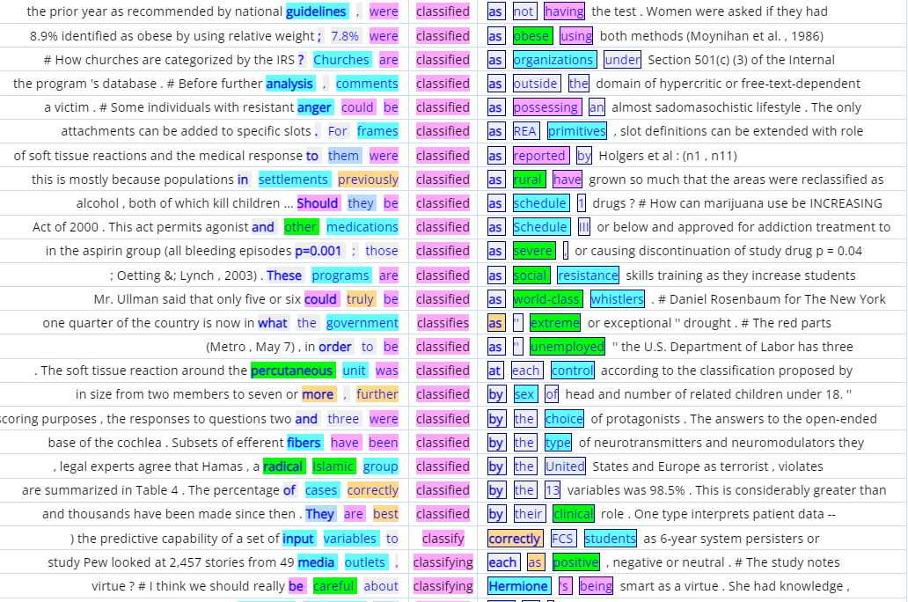
Prototypical data-driven learning
Meaning
Pattern of use

Slide 4
Data-driven learning
Improving attitudes and motivation
Empowering
Gains in word knowledge
Enabling self-correction
Exposure to authentic language
Gaining additional skills (e.g. noticing)
Overwhelming data
Demanding
Only fits with some learning styles
Inappropriate for low-level learners

Slide 5
Teacher-led inductive learning

Slide 6
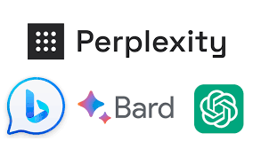
Uses of genAI in education
Identify genre structures
Answer questions
Generate course materials
Provide example sentences
Summarise information
Generate lesson plans
Prepare for exams
Provide translations
Generate assessment tasks
Highlight important phrases
Assist drafting
Evaluate student performance
Provide feedback
Explain grammar
Identify meanings of words
Lo (2023)
Kohnke et al. (2023)
Kasneci et al. (2023)
Suggest style improvements
Explain mistakes
Correct mistakes
Provide step-by-step solutions
Create genre-specific texts
Generate essay outlines

Slide 7
Data sources in DDL
Elicit example sentences from 10 colleagues
Elicit 10 example sentences from ChatGPT and Bard
COCA Analyze Texts

Slide 8
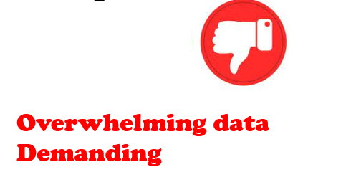
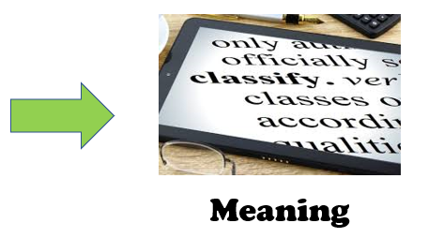
Evaluating data sources in DDL
Ease of understanding and use
Appropriacy for inducing meanings of words
Appropriacy for inducing patterns of use

Slide 9
 | Corpus | Teacher | GenAI
Ease of understanding
Inducing meanings
Inducing patterns

Slide 10
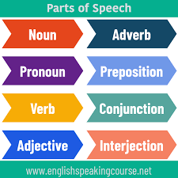
Words to investigate
progress
classify
awesome

Slide 11
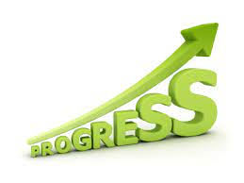
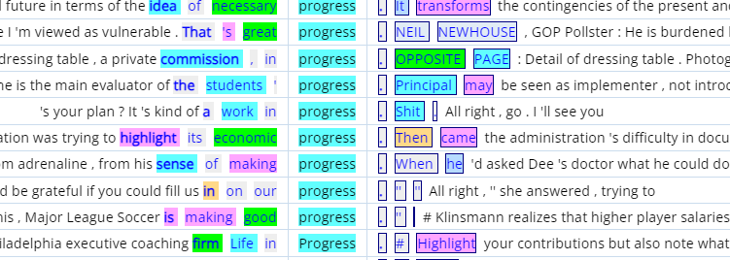
98 concordance lines
Ease of understanding
Benefits of colour coding
Processing load
Complexity of examples
Inducing meaning
Positive collocates
Economic progress
Work-in-progress
Inducing patterns
41% end of sentence/clause
8% after ‘in’
7% after [make]

Slide 12
You have made good progress.
The children's progress is unsatisfactory.
Where is my progress report?
My son made rapid progress in learning French.
The negotiation is in progress.
Ease of understanding
Simple short examples
High-frequency vocabulary
Inducing meaning
Little support
Inducing patterns
5% after [make]

Slide 13
Ease of understanding
Moderately complex examples
Inducing meaning
Evidence available
Inducing patterns
ChatGPT: 70% headword in noun phrase
Bard: 33% The progress of the [N] is

Slide 14
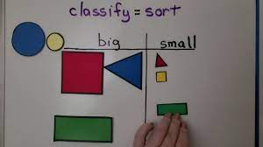
ChatGPT: When you recycle, you should classify your waste into categories like glass, paper and plastic.
Bard: The teacher classified the students into different reading levels
N classified NN into/as
Corpus Ease of understanding Complex Inducing meaning Unclear Inducing patterns 78% classified (V3) 40% classified as 40% [be] classified | Teacher Ease of understanding Straightforward Inducing meaning Moderate Inducing patterns 44% classified (V3) 22% classified into | GenAI Ease of understanding Moderate Inducing meaning Support provided Inducing patterns ChatGPT 100% classify Bard 100% classified (V2)

Slide 15
Bard: This new restaurant is awesome! The food is delicious and the service is excellent.
Corpus Ease of understanding Complex Inducing meaning Unclear Inducing patterns 50% sentence-final 32% [be] awesome | Teacher Ease of understanding Straightforward Inducing meaning Unclear Inducing patterns 61% sentence-final 33% [be] awesome “Awesome!” | GenAI Ease of understanding Straightforward Inducing meaning Support provided Inducing patterns ChatGPT 0% sentence-final Bard 50% sentence-final

Slide 16
 | Corpus | Teacher | GenAI
Ease of understanding |  | ✓
Inducing meanings |  |  | ✓
Inducing patterns | ✓
Variety of patterns with colour coding
Complex overloading
Simple sentences using high frequency vocabulary
Too simple
Frequent explanatory clauses
Limited repetitive patterns

Slide 17
Appropriate data sources in DDL
Ease of understanding and use
Appropriacy for inducing meanings of words
Appropriacy for inducing patterns of use

Slide 18
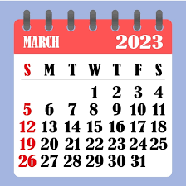
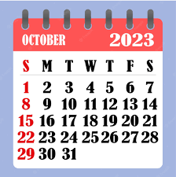
The evolution of genAI
The view from the top of the mountain was truly awesome.
The view from the mountaintop was absolutely awesome, with breathtaking scenery in every direction.

