Slide 1

Generative AI in research: Uses and abuses
Richard Watson Todd
King Mongkut’s University of Technology Thonburi

Slide 2
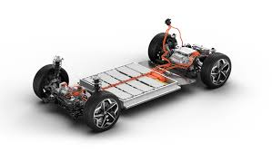

AI in scientific research
Researchers used AI to design a new material that they used to build a working battery – it requires up to 70 percent less lithium than some competing designs.
New Scientist January 2024
An AI model trained on chemical and perceptual data on 250 Belgian beers can predict the flavour profile of a brew – and how to make it tastier
New Scientist March 2024

Slide 3

Elsevier AI guidelines
Declaration of generative AI in scientific writing
Does this policy refer to AI and AI-assisted tools that are used in the research process, for example to process data?
No, this policy refers to generative AI and AI-assisted technologies, such as Large Language Models, when they are used during the scientific writing process. This policy does not prevent the use of AI and AI-assisted tools in formal research design or research methods. We recognize that this is common in many fields. Where AI or AI-assisted tools are used in this context, they should be described as part of the methodology of the work, with details provided in the Methods section.

Slide 4
Elsevier AI guidelines
Declaration of generative AI in scientific writing
Does this policy refer to AI and AI-assisted tools that are used in the research process, for example to process data?
No, this policy refers to generative AI and AI-assisted technologies, such as Large Language Models, when they are used during the scientific writing process. This policy does not prevent the use of AI and AI-assisted tools in formal research design or research methods. We recognize that this is common in many fields. Where AI or AI-assisted tools are used in this context, they should be described as part of the methodology of the work, with details provided in the Methods section.
Humanities and Social Science research?

Slide 5




AI in humanities and social sciences research
Conceptualisation
Topic choice
Research design
Instrument design
Literature review
Data analysis
Writing up

Slide 6
Conceptualisation: How top researchers find topics
Data-first research
  “This began with a contract [to create a corpus] based on a call for proposals. Once we had done the corpus building and initial linguistic analyses, I began to ask what other research questions I could study given that resource.”
Experiences which stimulate curiosity
  “This paper originally arose out of my anecdotal observations of the ways in which various language learners at my university were making use of the computer-based provisions in the language resource centres. It sought to find out what the practices and perceptions of learners [were] and to consider these in relation to current thinking on computer assisted language learning and learner autonomy.”
Building on previous research
  “I had done previous studies like this but lacked the tools (namely extensive computerized word lists) to do the research properly. I guess in this respect the source of the idea was my own previous studies which I was dissatisfied with.”
Inspiration from outside applied linguistics
  “Some years before I had read James Gleick’s book Chaos: The Making of a New Science, and my understanding of language and its acquisition was transformed as a result. This book had nothing to do with language, but rather with complex, nonlinear, dynamic systems in nature. Nonetheless, it provided a much more satisfying way of dealing with issues of second language acquisition which I have been investigating for years.”
Source: Watson Todd (2011)

Slide 7


Using genAI to find a research topic
Can you suggest 5 useful specific topics for applied linguistics research?
The Impact of Gamification on Second Language Motivation and Learning Outcomes: This research could explore the effectiveness of incorporating game mechanics and elements into language learning apps or classrooms. It could investigate if gamification increases student motivation, engagement, and ultimately, their proficiency in the target language.
Language Acquisition in Virtual Reality Environments …

Slide 8
Using genAI to find a research topic in a specific area
I'm interested in how non-native non-local teachers of English (e.g. Filipinos teaching English in Thailand) are perceived. Can you suggest 5 specific research topics?
Beyond Pronunciation: Examining the Strengths of Filipino Teachers of English in Thailand: This research could move beyond potential pronunciation concerns and explore the strengths that Filipino teachers bring to the classroom. Analyze areas like grammar expertise, innovative teaching methods, or effective use of technology in language learning.
The Impact of Language Learning Background on Teacher Efficacy: A Case Study of Filipino Teachers in Thailand …

Slide 9
Using genAI to explore choices in research design
For your suggestion of Beyond Pronunciation: Examining the Strengths of Filipino Teachers of English in Thailand, can you suggest some research instruments I might use?
Lesson Analysis: Collect and analyze lesson plans or video recordings of Filipino teachers' classes. Focus on elements like variety of activities, use of visuals or real-world examples, opportunities for student participation and interaction, and differentiation strategies to cater to different learning styles.
Focus Groups …

Slide 10
Using genAI to explore details in research design
If I decided to use focus groups with students, what questions might I ask?
Strengths and Teaching Methods:
Can you describe some teaching methods or strategies used by your Filipino teachers that you found particularly helpful in learning English?
…
Cultural Understanding and Benefits
Have your Filipino teachers incorporated any cultural aspects or references into their English lessons that you found interesting or helpful?
…

Slide 11
Using genAI to explore details in research design
How can I run a focus group interview to ensure that every participant has a roughly equal chance to share?
Ground Rules: Establish ground rules at the beginning of the session. These could include taking turns speaking, actively listening to others, and avoiding interrupting.
Moderator Role: The moderator plays a crucial role in facilitating equal participation. Use active listening skills, acknowledge contributions, and make eye contact with all participants.
…

Slide 12

Non-genAI research conceptualisation
Conclusion: GenAI can be used as a sounding board to help develop and refine research ideas

Slide 13

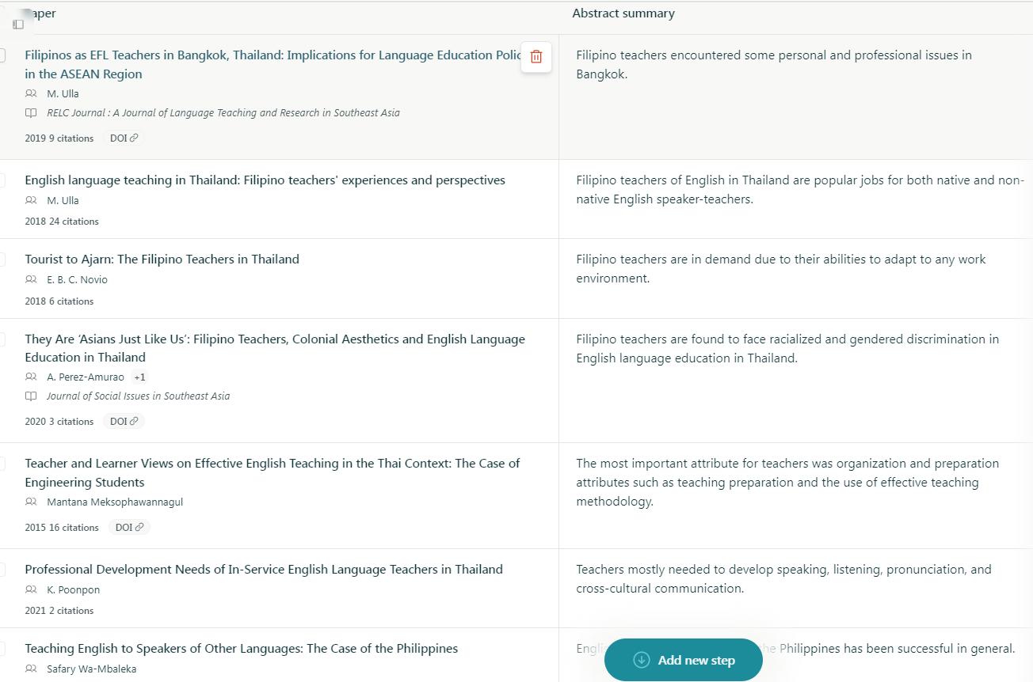

Using genAI to find research articles
Strengths of Filipino Teachers of English in Thailand

Slide 14


Using genAI to find research articles
Strengths of Filipino Teachers of English in Thailand

Slide 15


Using genAI to find research articles
Strengths of Filipino Teachers of English in Thailand

Slide 16

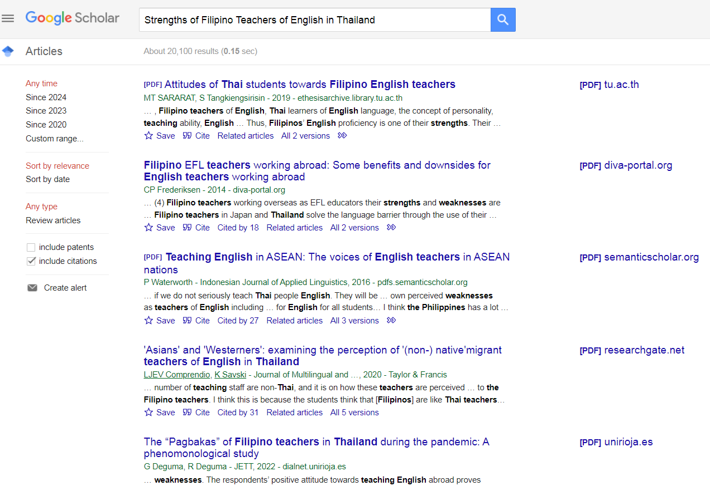
Using non-genAI to find research articles
Strengths of Filipino Teachers of English in Thailand

Slide 17
Finding research articles
Somewhat useful for gaining an overview of an unfamiliar area
Filipino teachers of English in Thailand exhibit various strengths. They excel in utilizing communicative strategies such as "Listen to the message" and "Persuasion"[1]. Additionally, they cope with demotivating factors through self-regulation and pedagogical strategies[2]. Despite facing challenges like students' lack of interest and inadequate English language curriculum, Filipino teachers remain positive about teaching English in Thailand[3]. Furthermore, their experiences as Teacher Education graduates contribute to their effectiveness in the classroom, showcasing their adaptability and resilience in a foreign teaching environment[4].
Useful for in-depth literature reviews
Conclusion: GenAI cannot currently be used for in-depth literature reviews

Slide 18



Automated data analysis
Statistics
Corpus
Text analysis
Discourse analysis
SPSS
AntConc
CohMetrix
GenAI

Slide 19
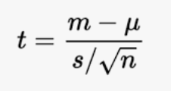
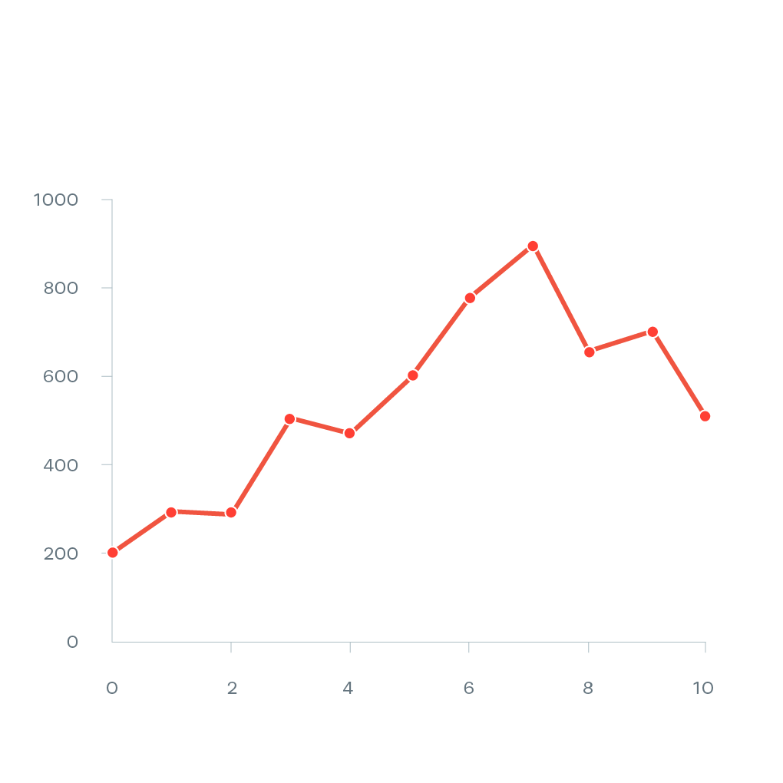

Using genAI to analyse data
Statistics
SPSS
R
Use genAI to generate code for R

Slide 20
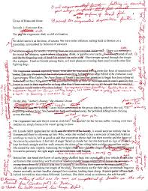
Using genAI to analyse data
Scoring essays
60 years of Automated Essay Scoring (AES) research
State-of-the-art AES better than basic genAI
Reasonable correlations between humans and genAI
GenAI consistently scores higher than humans
GenAI can provide support for better human scoring
Conclusion: GenAI currently inappropriate as an independent essay scorer, but likely in the near future

Slide 21
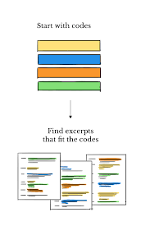
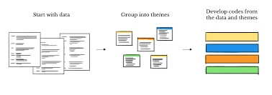
Using genAI to analyse data
Coding texts
Deductive coding
Inductive coding

Slide 22

Using genAI to analyse data
Coding texts with basic genAI (ChatGPT 3.5)
Limitations in text length
Need for substantial experimentation in prompt structure and phrasing
Moderate reliability scores compared to humans
Better at deductive coding than inductive coding
Conclusion: Basic genAI is inappropriate for inductive coding and of debatable value for deductive coding

Slide 23

Using genAI to analyse data
Coding texts with advanced genAI (ChatGPT4 Turbo)
Can input relatively long texts
Need to add APIs
Need for substantial experimentation in prompt structure and phrasing
High reliability scores compared to humans
Better at deductive coding than inductive coding
Best when used as a support for human coding: LLM-assisted content analysis (LACA)
Conclusion: Advanced genAI can be used for deductive coding or as a collaborator for both deductive and inductive coding

Slide 24

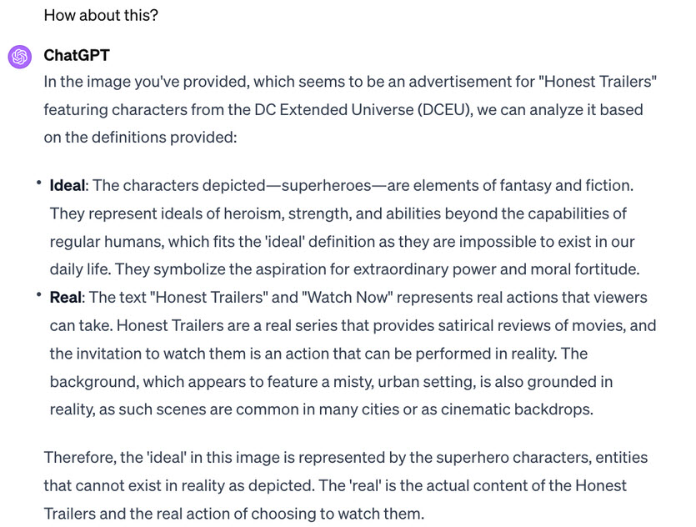
An example of genAI coding
Background: Multimodal analysis is largely based on Kress & van Leeuwen (2006)
Objective: To test the validity of K&vL’s theory of Ideal – Real (ideal components near top; real components near bottom)
Data: 1599 online adverts
Coding 1: Top vs. bottom components
Coding 2: Text and images coded as ideal vs. real

Slide 25

Using genAI in writing
Understanding expectations
Generating text
Editing text

Slide 26

Using genAI in writing: Understanding expectations
Dealing with unfamiliar genres
Research funding proposal requires a marketing statement
Sections in the marketing statement:
Problem & Target Audience
Solution & Benefits
Market Potential & Competitive Advantage
Call to Action

Slide 27
Using genAI in writing: Generating text
Once a foundational intimacy with the data was established, the study progressed to generating initial open codes. In this iterative phase, specific data sections were earmarked and tagged with codes, either emanating directly from participants’ verbiage or from proximate interpretations. These initial annotations set the stage for discerning overarching themes, wherein these codes were systematically grouped based on inherent patterns, synergies, or contrasts.
Words in 6k-10k range
Words in 11k-15k range

Slide 28
Using genAI in writing: Generating text
Once a foundational intimacy with the data was established, the study progressed to generating initial open codes. In this iterative phase, specific data sections were earmarked and tagged with codes, either emanating directly from participants’ verbiage or from proximate interpretations. These initial annotations set the stage for discerning overarching themes, wherein these codes were systematically grouped based on inherent patterns, synergies, or contrasts.
Words in 6k-10k range
Words in 11k-15k range

Slide 29

Using genAI in writing: Generating text
10 words in 6k-10k range
56 words in 6k-10k range
GenAI text is stilted, clunky and boring

Slide 30
Elsevier AI guidelines
Declaration of generative AI in scientific writing
Where authors use generative artificial intelligence (AI) and AI-assisted technologies in the writing process, authors should only use these technologies to improve readability and language.
Do not use genAI to generate text for articles

Slide 31
Using genAI in writing: Editing text
Original text
There were few limitations to this research in terms of its time, participants, etc. First and foremost was the problem the researcher had with the participants. Since the tests and questionnaires administration time was somehow long, some of the respondents felt bored and might have not given sufficient consideration required for answering the questions, and as a result could have endangered the internal validity of the research.
Can you rewrite …
While this study faced minimal logistical limitations, participant engagement emerged as a key challenge. The lengthy testing and questionnaires might have led to participant boredom, potentially compromising the accuracy of their responses. This could impact the internal validity of the research.
Can you edit …
This research encountered minimal limitations regarding time, participants, and other logistical aspects. However, participant engagement emerged as a primary concern. The lengthy administration time for tests and questionnaires could have led to boredom among some respondents. This, in turn, might have affected the quality of their responses and potentially jeopardized the internal validity of the research.

Slide 32
Using genAI in writing: Editing text
Original text
There were few limitations to this research in terms of its time, participants, etc. First and foremost was the problem the researcher had with the participants. Since the tests and questionnaires administration time was somehow long, some of the respondents felt bored and might have not given sufficient consideration required for answering the questions, and as a result could have endangered the internal validity of the research.
Can you rewrite …
While this study faced minimal logistical limitations, participant engagement emerged as a key challenge. The lengthy testing and questionnaires might have led to participant boredom, potentially compromising the accuracy of their responses. This could impact the internal validity of the research.
Can you edit …
This research encountered minimal limitations regarding time, participants, and other logistical aspects. However, participant engagement emerged as a primary concern. The lengthy administration time for tests and questionnaires could have led to boredom among some respondents. This, in turn, might have affected the quality of their responses and potentially jeopardized the internal validity of the research.

Slide 33
Using genAI in writing: Editing text
Original text
There were few limitations to this research in terms of its time, participants, etc. First and foremost was the problem the researcher had with the participants. Since the tests and questionnaires administration time was somehow long, some of the respondents felt bored and might have not given sufficient consideration required for answering the questions, and as a result could have endangered the internal validity of the research.
Can you rewrite …
While this study faced minimal logistical limitations, participant engagement emerged as a key challenge. The lengthy testing and questionnaires might have led to participant boredom, potentially compromising the accuracy of their responses. This could impact the internal validity of the research.
Can you edit …
This research encountered minimal limitations regarding time, participants, and other logistical aspects. However, participant engagement emerged as a primary concern. The lengthy administration time for tests and questionnaires could have led to boredom among some respondents. This, in turn, might have affected the quality of their responses and potentially jeopardized the internal validity of the research.

Slide 34
GenAI in humanities and social sciences research
Conceptualisation
Topic choice
Research design
Instrument design
Literature review
Data analysis
Writing up
GenAI can be used as a sounding board to help develop and refine research ideas
GenAI cannot currently be used for in-depth literature reviews
Advanced genAI can be used for deductive coding or as a collaborator for both deductive and inductive coding
GenAI cannot be used to generate text but may help to edit text

